Slide 1
Презентация по теме «WEATHER»
Выполнила: учитель английского языка Чернова Елена Сергеевна
МКОУ «Троицкая СОШ № 62»

Slide 2
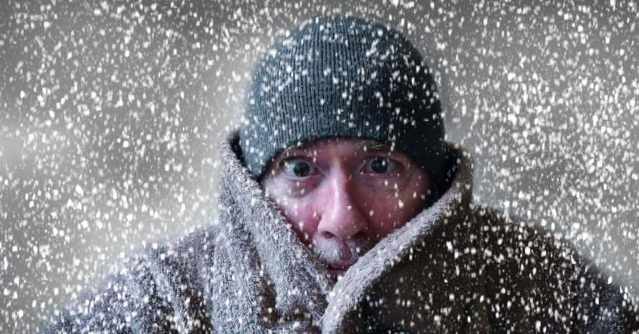
Can you guess what we will talk about?

Slide 3
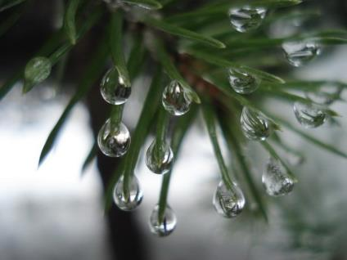
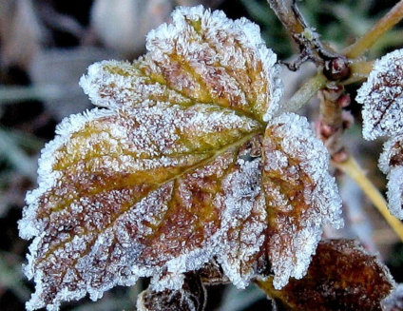
Can you guess the name of the event?
t____________
h_______________

Slide 4
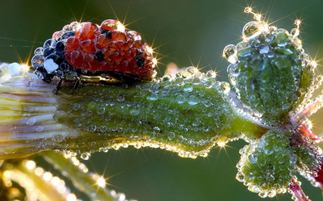
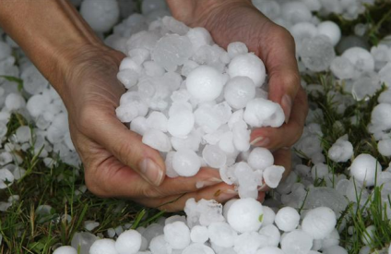
Can you guess the name of the event?
d____________
h_____________

Slide 5
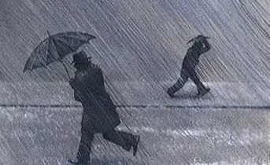
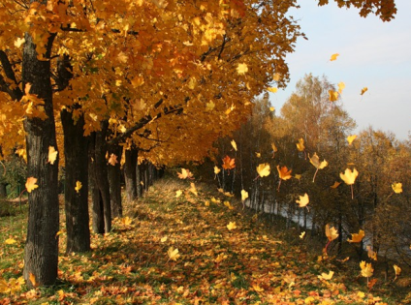
Can you guess the name of the event?
S________________
F________________

Slide 6

Fill in the cluster: words connected with weather!!! How many of them do you remember?
Weather

Slide 7
Distribute the words into four groups:
Breeze Rainfall (осадки) Snowflake Dew Thaw Drizzle (мелкий дождь) To blossom Dull (пасмурный) To freeze Drip (капель) To glow (светиться) Fog To melt Hail (град) To melt Hoarfrost Humidity Lightning
Winter | Spring | Summer | Autumn

Slide 8
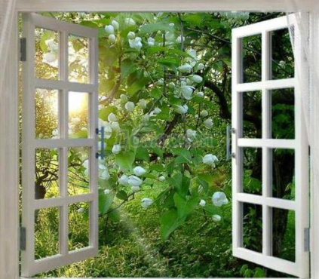
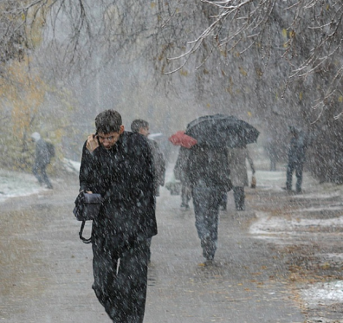
How would you react if you see such a weather-picture through the window?
_______________________!!!
_______________________!!!

Slide 9
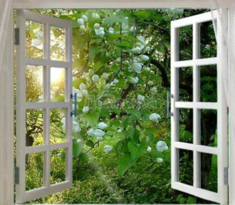
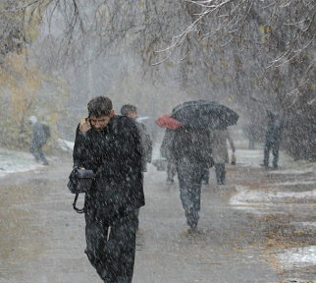
Check yourself! Do you keep in mind such expressions?
Lovely day, isn’t it?
Marvelous!
The weather is wonderful!
The sun makes a nice change, doesn’t it?
It’s getting better.
It’s a dreadful morning, isn’t it?
The weather is nasty.
Yesterday was awful, wasn’t it?
It’s pouring.
It’s getting worse and worse.

Slide 10
Guess the translation of the idioms?
1) A fair-weather friend
2) To be cloudy about something
3) To be full of hot air
4) To be windy
5) To save something for a rainy day
6) To be under the weather
7) To clear the air
8) To get a second wind
9) Brainstorm
10) Out of the blue
11) To steal someone’s thunder
1) Мозговой штурм
2) Нежданно-негаданно
3)Откладывать на черный день
4) Быть неуверенным в чем-то
5) Присвоить чьи-то заслуги
6) Чувствовать себя нехорошо
7) Говорить чепуху
8)Обрести второе дыхание
9) Ненадежный друг
10) Положить конец недоразумениям
11) Быть болтливым

Slide 11
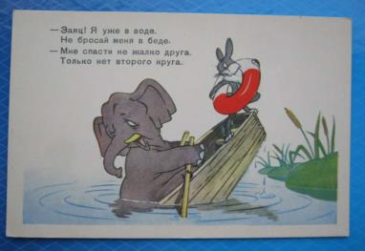
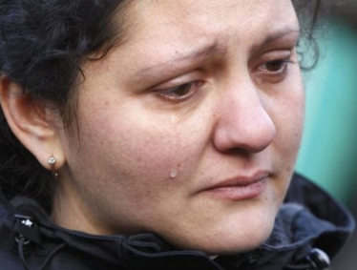
Answer the questions? Use the idioms!
Have you got
such a friend?
Are you often like
this about something?

Slide 12

Some wise sayings…Give Russian equivalents…
1) After rain comes fair again.
2) It never rains, but it pours.
3) Small rain lays great dust.
4) Make hay while the sun shines.
5) There’s not bad weather there are bad clothes.
6) Everything is good in its season.
7) Sow the wind and reap the whirlwind.
8) One swallow doesn’t make a summer.
9) There is nothing new under the sun.
Can you comment on them? Are they really connected with weather?

Slide 13
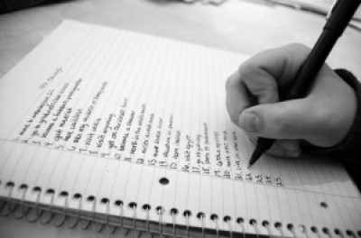
Well, sum up all you’ve managed to remember and compare your list with your classmates’! Good luck!

Slide 14
Thank you for attention!
The end!

