Slide 1
Урок английского языка
в 10 классе по теме
“Elections of the Russian President”
(выборы Российского президента),
проведенный в ноябре 2017 г.
Учитель Решетникова З.Б.

Slide 2
What political event will we have on the 18th of March?

Slide 3
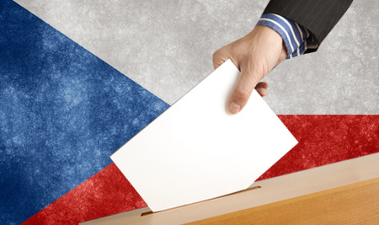
So today I invite you to discuss the topic “Elections of the Russian President”.

Slide 4
Pair work
Irina + Yana
Nastya+ Max
Anya + Roman
Nikita +Galya
Kris + Natasha

Slide 5
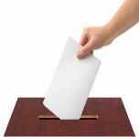
New words
Constitution of Russia, the Central Electoral Committee, candidates, President’s post, an article, candidate’s form, to nominate for, can be registered, may be elected, suffrage (изб. право), ballot (голосование), permanent residence, will be determined, federal law, can be characterized,

Slide 6
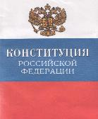
Article 81 The Russian Constitution
The President of the Russian
federation will be elected for 6 years by citizens of the Russian federation on the basis of universal, equal, direct suffrage by secret ballots.
2. Any citizen of the Russian federation not younger than 35 years of age and with a permanent residence record in the Russian federation of not less than 10 years may be elected President of the Russian federation.
3. One and the same person may not be elected President of the Russian federation for more than 2 terms running.
4. The rules for electing the President of the Russian Federation will be determined by the Federal law.

Slide 7
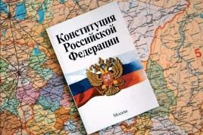
Task
You are members of the Central Electoral Committee of Russia. You must read the candidates’ forms. Then according to the Russian Constitution you are to decide who can be nominated for presidential elections and who of them can’t. You also should explain your decision.

Slide 8
Name: Anton Surname: Petrov Place of birth: Moscow Date of birth: 22/06/78 Occupation: teacher Nationality: Russian Residence: Russia He hasn’t lived abroad. | Name: Maria Surname: Filatova Place of birth: Petrozavodsk Date of birth: 15/07/65 Occupation: shop assistant Nationality: Russian Residence: Russia She hasn’t lived abroad.
Name: Vladimir Surname: Strekalov Place of birth: St. Petersburg Date of birth: 7/10/52 Occupation: Trade manager Nationality: Russian Residence: Russia He lives in Russia. | Name: Ville Surname: Poikko Place of birth: Helsinki Date of birth: 4/12/59 Occupation: businessman Nationality: Finnish Residence: Russia He has been living in Russia for 15 years.
Name: Semyon Surname: Malinin Place of birth: Tula Date of birth: 30/01/68 Occupation: scientist Nationality: Russian. Residence: Russia He has been living in France for 6 years. | Name: Pyotr Surname: Smirnow Place of birth: Taltsa Date of birth: 17/02/1970 Occupation: economist Nationality: Russian Residence: Russia He hasn’t lived abroad.

Slide 9
Table for filling
№ | Name | Yes/no | Short explanation
1 | Anton Petrov
2 | Maria Filatova
3 | Vladimir Strekalov
4 | Ville Poikko
5 | Semyon Malinin
6 | Pyotr Smirnov

Slide 10
CANDIDATES

Slide 11
Discussion
1. The 1st group of people thinks every citizen of Russia must go to elections. The other group of people supposes it’s not obligatory to take part in elections. What group do you support? Why? (To elect deserved people, to influence the policy and economy, youth must not be infantile)
2.If you were 18 years old, would you take part in elections on the 18th of March?
3. How can you
characterize a future
president of Russia?

Slide 12
Personal characteristics of the President of Russia:
to be a patriot –
not selfish –
to love people –
can be able to work in a team –
to be brave –
to be well educated –
to be very smart –
must know economics, politics, law –
have a good health-
to be strong in spirits –

Slide 13
Estimation card
Kind of work | Notes | Why?
Pair work Irina + Yana Nastya+ Max Anya + Roman Nikita +Galya Kris + Natasha 2. Oral work Irina + Yana Nastya+ Max Anya + Roman Nikita +Galya Kris + Natasha |  | Work hard - Speak much - Be active - Show good knowledge -

